Slide 1


Slide 2
objectives
Acquire live images from webcam to facilitate optical flow and face detection
Apply color segmentation on camera feed to track colored objects
1
2
3
Physics-301/Activity - 4 RGB-to-Spectra using PCA.ipynb at main · reneprincipejr/Physics-301 (github.com)
https://drive.google.com/file/d/11YbzA_dpg4L-_9xB1E44XnfDiXXtFVsc/view?usp=sharing

Slide 3
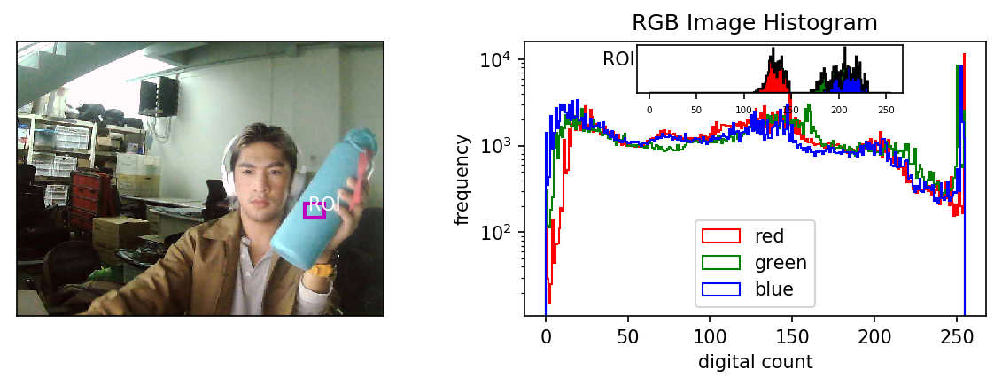
Video Capture (OpenCV)
In this activity, the camera feed is loaded using Open-CV Python [1]. The main principle of video processing is that videos are a collection of sequential images, hence, the image processing techniques can still be applied frame by frame. Shown below is a snapshot from the webcam and the corresponding histogram of the image and a region of interest (ROI). The entire image has a continuous distribution across all channels while the ROI is distinguishable by its narrow distribution.

Slide 4
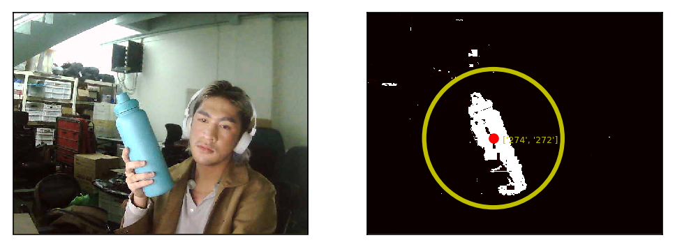
Blob detection
Non-parametric segmentation uses the histogram back-projection, a non-computational technique since it treats histograms as just look-up tables [2][3]. Recall that in Activity 1, the non-parametric method was generalized to be robust to intensity variation and can sometimes reveal extra details. This may be beneficial in this activity especially that we’re dealing with scenes in very non-ideal conditions. Shown below is the sample segmentation of the blue aquaflask. Since we aim to track the ROI’s movement, we employed blob detection using the image moments to get the centroid coordinates and bound the region in a circle [4].

Slide 5

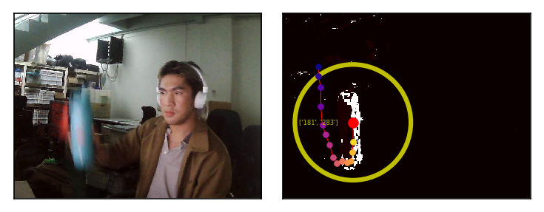
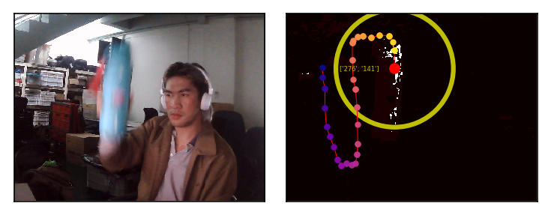
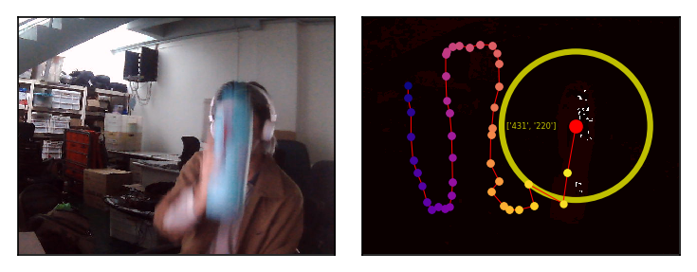
Tracking
From the webcam live feed, we process 100 frames. For reference, I moved the aqua flask in a sinusoidal manner. Shown below are some snapshots at different times:
FRAME 1 FRAME 25 .
FRAME 50 FRAME 75 .

Slide 6
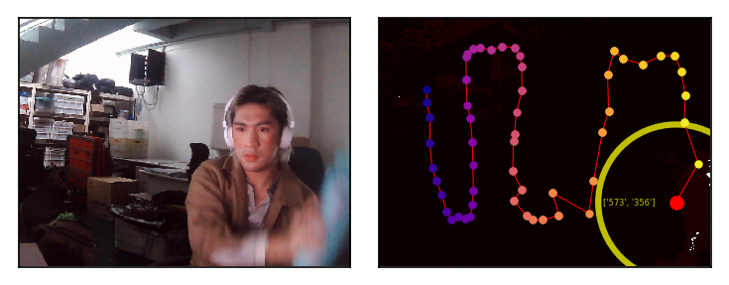
Discussion
We were able to acquire live images from webcam and applied color segmentation. Fundamental problems include the (1) built-in white balancing in the webcam used which drastically changes the colors in the scene and (2) poor resolution and low-frame rate of webcams. The effects are evident on the later half of the tracking where the color segmentation struggles, consequently affecting the centroid detection. Overall, the tracking algorithm worked, and objectives were met.

Slide 7
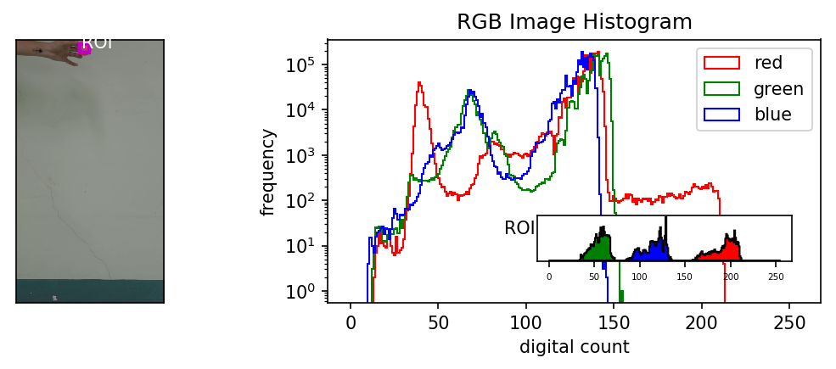
Applications
For

Slide 8
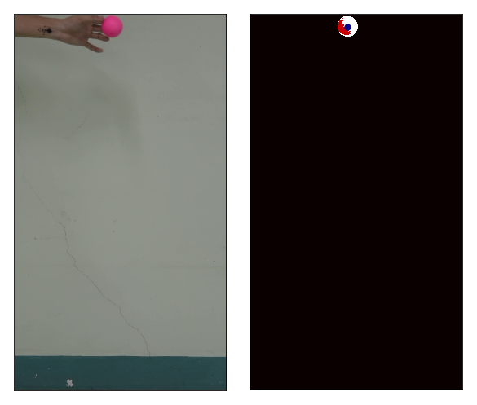
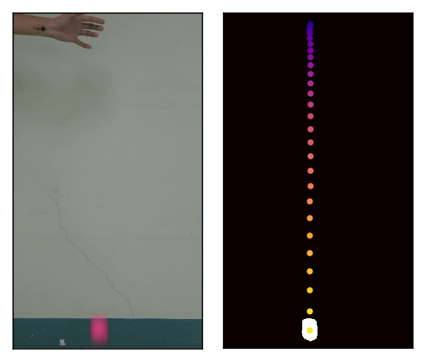
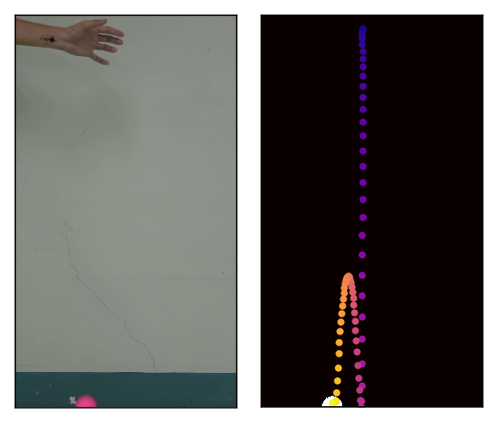
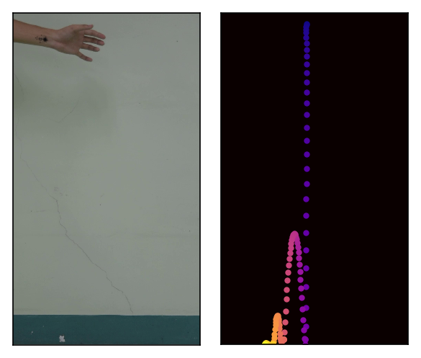
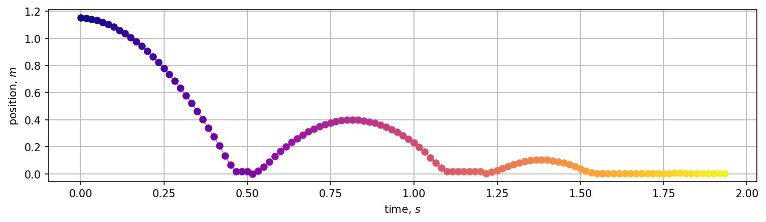
Free Fall

Slide 9
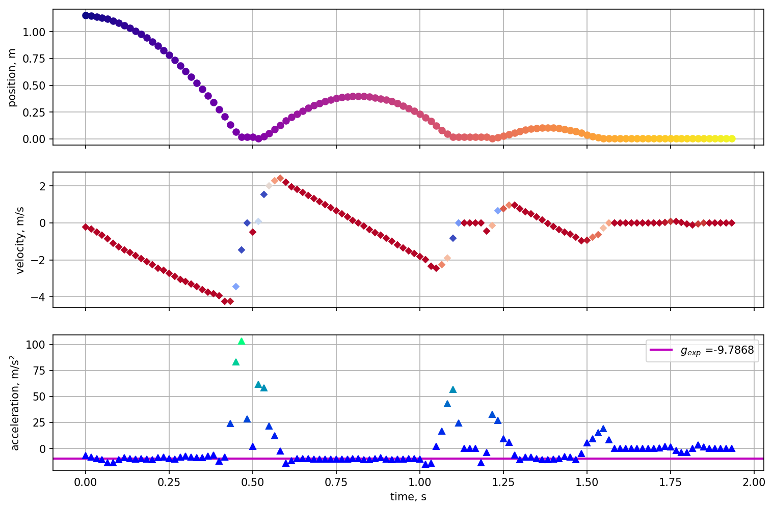

Slide 10
reflection
As mentioned previously, I have used PCA before in spectral resolution but in this report, I was able to compare how the method fared across all different light sources. The visualizations were stand-alone and self-explanatory. One important finding is that it turns out, the skewed power distribution contributed to rendering spectra with large color difference. The take-away here is the same as what my undergraduate thesis proposed; we should implement both spectral and color error metrics to evaluate the spectral reconstruction.
In this activity, I’d give myself a score of 100/100.
[1] OpenCV: Getting Started with Videos
[2] M. Soriano, Applied Physics 186 - Image Segmentation, (2019).
[3] M. Soriano, Physics 301 - Color Segmentation, (2022).
[4] Find Center of a Blob (Centroid) Using OpenCV (C++/Python) | LearnOpenCV

